Slide 1
Topic:Airline Dataset Analysis
REVA Academy for Corporate Excellence (RACE)
Date: 25-03-2026
Rajendra Rathod
FT – 04 (M tech in Cyber Security)
Data Management System using Excel and Power BI
www.race.reva.edu.in

Slide 2
Contents
01
Introduction
05
Objectives
02
Objectives
06
Dashboard layout
03
Dataset Overview
07
Recommendations
04
Problem Statement
08
Conclusion

Slide 3
Introduction
The Airline Dataset Analysis Dashboard focuses on understanding flight pricing patterns and travel behavior.
Using Power BI, the dataset is analyzed to identify key factors affecting ticket prices such as class, duration, stops, and booking time.
It is mainly used to analyze flight pricing, travel patterns, and customer booking behavior.

Slide 4
Problem Statement
Flight ticket prices vary significantly based on multiple factors, making it difficult for customers to make cost-effective decisions.
This project aims to analyze these variations and uncover pricing patterns.

Slide 5
Objectives
To analyze airline ticket pricing trends.
To identify factors affecting flight prices.
To compare airlines based on cost and performance.
To create an interactive dashboard for insights
To study the impact of booking timing (days left)

Slide 6
Dataset Overview
The dataset contains detailed flight information including airline name, source and destination cities, departure and arrival times, number of stops, travel class, duration, days left for booking, and ticket price
Link:-https://www.kaggle.com/datasets/kirtimathur/indian-airlines-data
Airline – Name of the airline operating the flight (e.g., IndiGo, Air India)
Flight – Unique flight number
Source City – City from where the flight departs
Departure Time – Time of departure (Morning, Afternoon, Evening, Night)
Stops – Number of stops (Non-stop, 1 stop, 2+ stops)
Arrival Time – Time when the flight reaches destination
Destination City – City where the flight lands
Class – Travel class (Economy / Business)
Duration – Total travel time of the flight
Days Left – Number of days left before departure (booking timing)
Price – Ticket price of the flight

Slide 7
Knowledge keywords
Insight → Meaningful conclusion from data
It is not just numbers — it explains what is happening and why it matters.
Example:-KPIs, cards, summary visuals
Trend → Direction of data over time
Is it increasing? decreasing? stable?
Example:-Axis = Time (Days, Month, Year),Line charts
Pattern → Repeated behavior in data or relationship in data
Does something happen again and again? These are patterns because they repeat consistently
Example:-represented in bar charts, scatter plots, heatmaps
Stakeholder → Person who uses the analysis or dashboard for decisions
They are the decision makers
Example:-Airline Managers → decide pricing strategy, Business Analysts → analyze performance

Slide 8
Approach
DAX Measures:
Average Ticket Price
Cheapest Airline
Most Expensive Route
Price vs Days Left Trend
% of Non-stop Flights

Slide 9
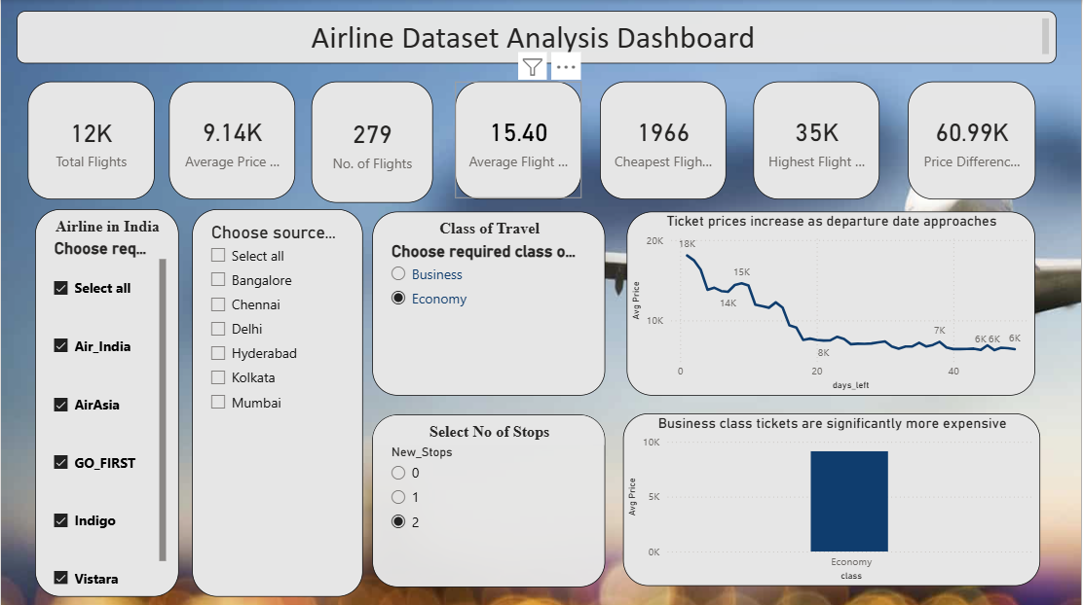
Dashboard Layout
Dashboard 1: KPI’s Summary

Slide 10
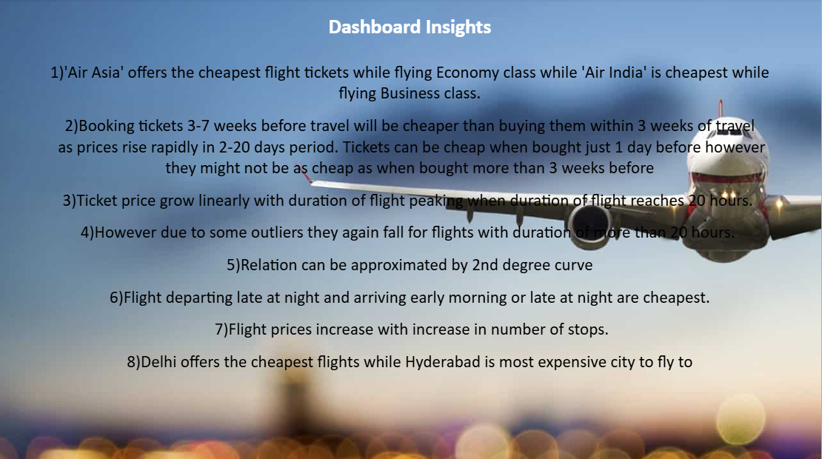
Dashboard Layout

Slide 11
Conclusion
This analysis provides valuable insights into airline pricing strategies and customer booking behavior. It helps users make better travel decisions and allows businesses to optimize pricing and service offerings.

Slide 12


